Slide 1
PROJECT SIMPLIFIER
A way to encourage students to create projects using basic programming language.

Slide 2
Introduction
Nowadays students in engineering colleges from Tamil Nadu are not into making Mini Projects. This makes them lack in research knowledge and considerably affects the maximum of their thinking capacity.
Students are not showing interest in other activities like Mini Project, Coding and debugging contest, etc. To make this condition change we have introduced this Mini Project.

Slide 3
The Thought
We have made Header files for two of the basic programming languages.
The Programming languages we considered are the languages that are taught in basic levels
We have concentrated on C and C++.
These header file will make the students feel easy to create projects.
We hope it create interest for students in coding and other programmatic stuff like databases manipulation etc.

Slide 4
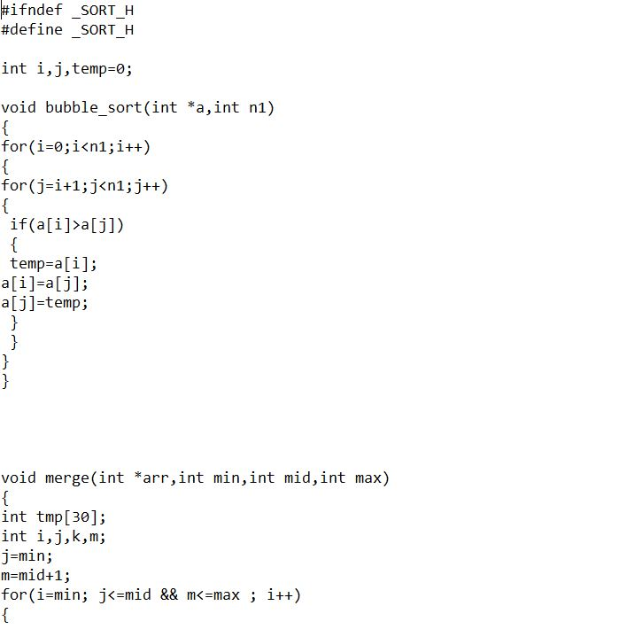
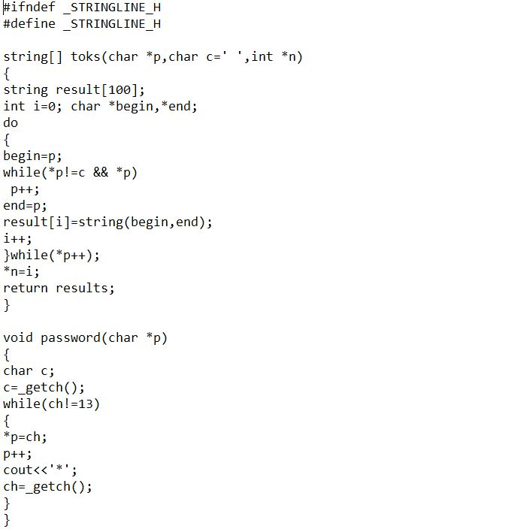
Sort.h
Stringline.h

Slide 5
Specialities of These header files
Anyone can create a header file?

Slide 6
Time Complexity
The functions in these header files are optimised for the basic levels.
We use online compliers to find out the time taken for each method in the function.
We have used the best functions to our knowledge so that others can use it without the problem of time exceeding for compiling.

Slide 7
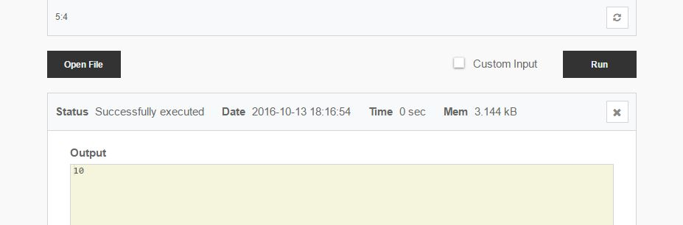

Slide 8
Space Complexity
Basically we used the same method as in time complexity.
Here we did a little more than just changing the codes.
We freed the memory used by the memory allocation techniques.
Thus users won’t be worried for the memory used by the variables of the functions.

Slide 9
Advantages
We expect colleges to introduce such header file to the students who don’t show interest in projects and other stuffs.
Users of these header files will find it easy to sort, search and other basic algorithms without worrying about the complexities.
Creating Projects will be easier and efficient using these header files.

Slide 10
Thank You
By
Adhil Roshan N A
Abhishek Nair M
Dondeti Sai Teja

